Slide 1
The Joys and Perils of Interdisciplinary Research
Jignesh M. Patel
University of Michigan

Slide 2

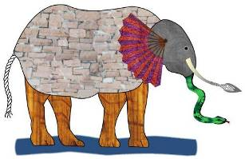
What is interdisciplinary
Definition:
  Research where the contributions of the various disciplines are integrated to provide holistic or systemic outcomes¹.
  Not a casual
  collaborative affair
¹Tait et al., Guidelines for interdisciplinary research and research managers

Slide 3

The Joys
Exposure to a wonderful new world
Continuous learning process
Potential impact is huge
Forced to be a broader computer scientist
Its different!

Slide 4

The Challenges
Steep learning curve
  Its obvious that “A recessive allele displays no
  influence on the phenotype in heterozygous individuals.”
Finding the right set of collaborators
  “Ah! You are a database guy. I have this Oracle database that ….”
Finding interesting, non-trivial computational problems
  What characterizes the similarity of two proteins?
  Domain knowledge based on intuition developed over many decades, fuzziness in everything, specialization ...
Publishing/funding is harder
Harder to motivate students (initially)

Slide 5

To be or not to be
To be
  A research style issue – a personal
  choice
    I love it!
  If you try make a serious effort, but remember your homebase.
  Better academic job prospects for students
Or not to be
  You can still be supportive of such research

